Slide 1


Yolanda Chen
Aug 6 2025

Slide 2

Predicting Falcon 9 First Stage Landing Success
Executive Summary
Introduction
Methodology
Results
Conclusion
Appendix

Slide 3
Executive Summary
Collected data from public SpaceX API and SpaceX Wikipedia page.
Explored data using SQL, visualization, folium maps,
and dashboards.
Gathered relevant columns to be used as features.
Visualize accuracy score of all models.
Four machine learning models were produced: Logistic Regression, Support Vector Machine, Decision Tree Classifier, and K Nearest Neighbors

Slide 4
Introduction
Problems you want to find answers:
Can we reliably predict if Falcon 9's first stage will land successfully based on historical launch data?
Describe the pain points of competing startups requiring low-cost rocket launches and explain the impact of predicting successful landings on bidding strategies.

Slide 5
Methodology
Executive Summary
Data collection methodology:
Describe how data was collected
Perform data wrangling
Describe how data was processed
Perform exploratory data analysis (EDA) using visualization and SQL
Perform interactive visual analytics using Folium and Plotly Dash
Perform predictive analysis using classification models
How to build, tune, evaluate classification models

Slide 6
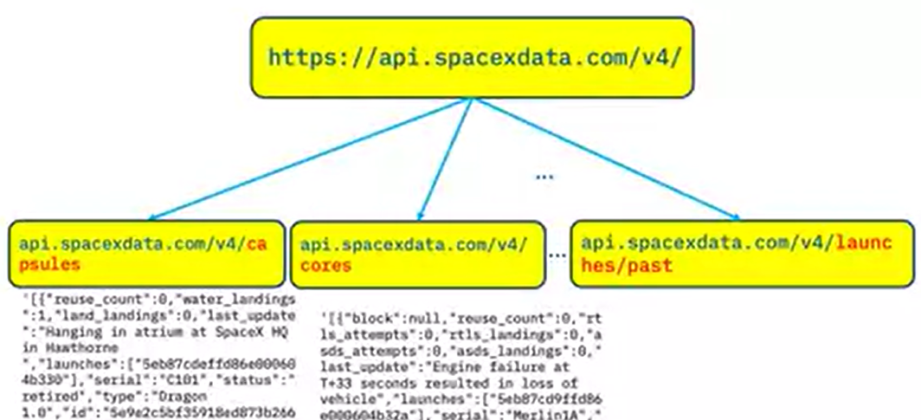
Data Collection – SpaceX API
Obtain official launch records through SpaceX API and supplement detailed data such as weather and launch location with web crawlers

Slide 7
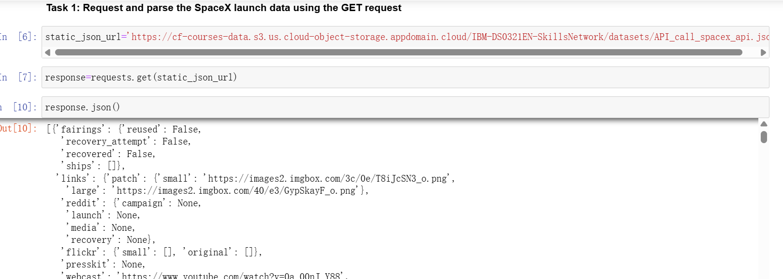
Data Collection – SpaceX API

Slide 8
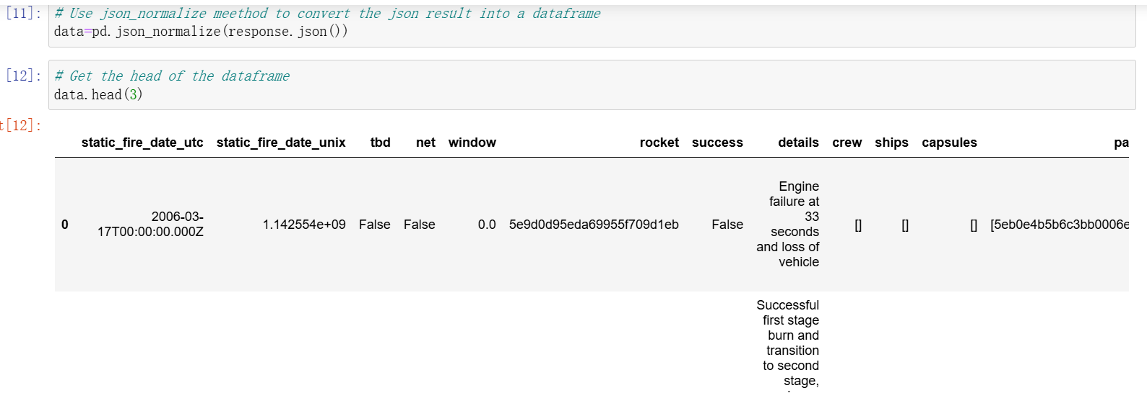
Data Wrangling
Focus on handling missing values (such as filling the payload_mass field with median) and detecting outliers (such as identifying engine thrust outliers through boxplots).
Pandas code snippets for key cleaning steps,
such as ` df. dropna (subset=['landing_outcome '])

Slide 9
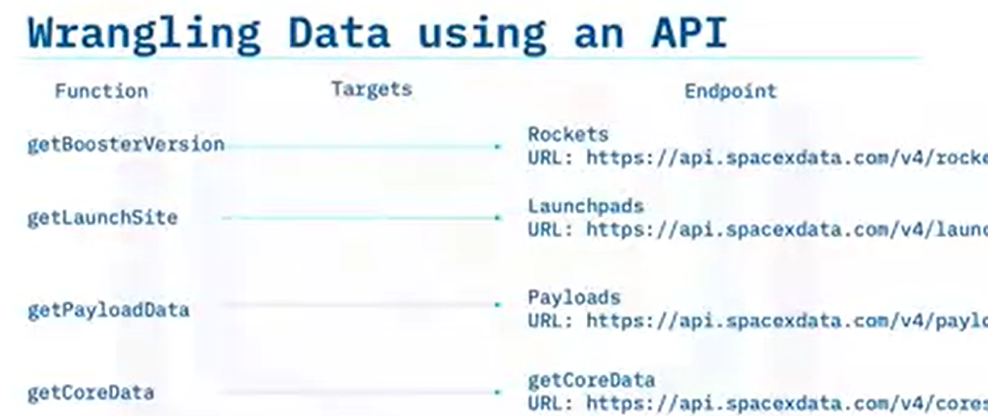
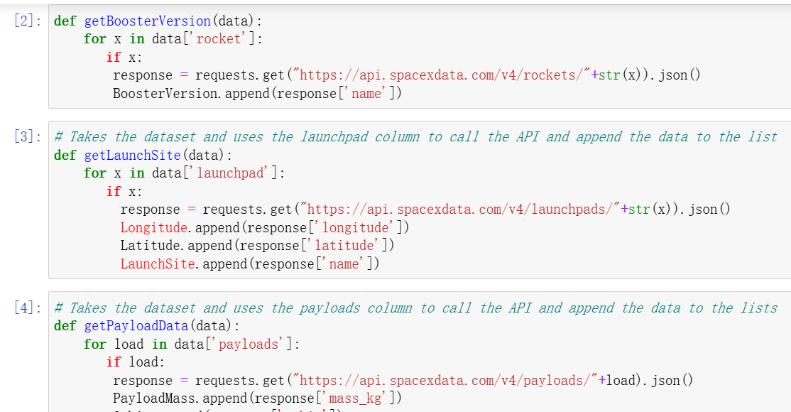
Data Wrangling

Slide 10
EDA with Data Visualization
Summarize what charts were plotted and why you used those chart

Slide 11
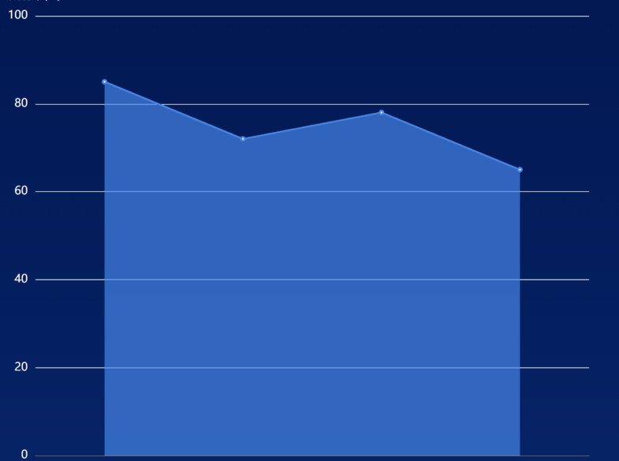
Success Rate vs. Launch Site
Compare the success rates of different locations such as the Kennedy Space Center, it was found that it had the highest success rate.
Success
Rate
Kennedy Vandenberg Cape Other
Space air force Canaveral Sites
Center base

Slide 12
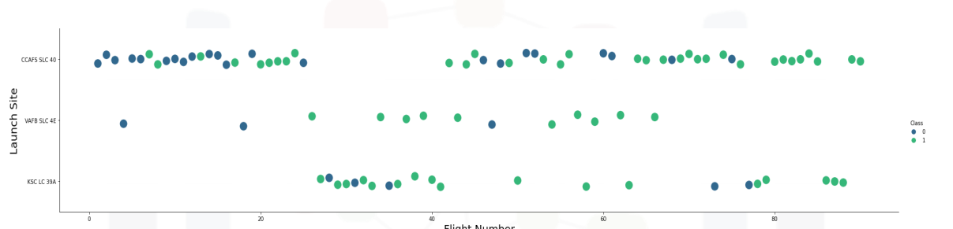
Flight Number vs. Launch Site
CCAFS appears to be the main launch site as it has the most volume

Slide 13
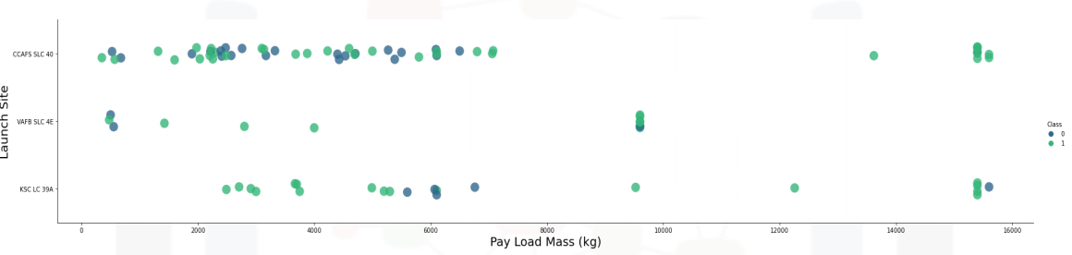
Payload vs. Launch Site
Payload mass appears to fall mostly between 0-6000 kg.

Slide 14
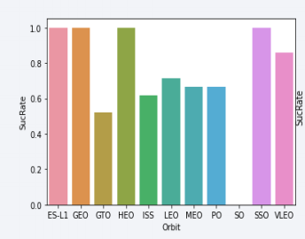
Success Rate vs. Orbit Type
GTO (27) has the around 50% success rate but largest sample.

Slide 15
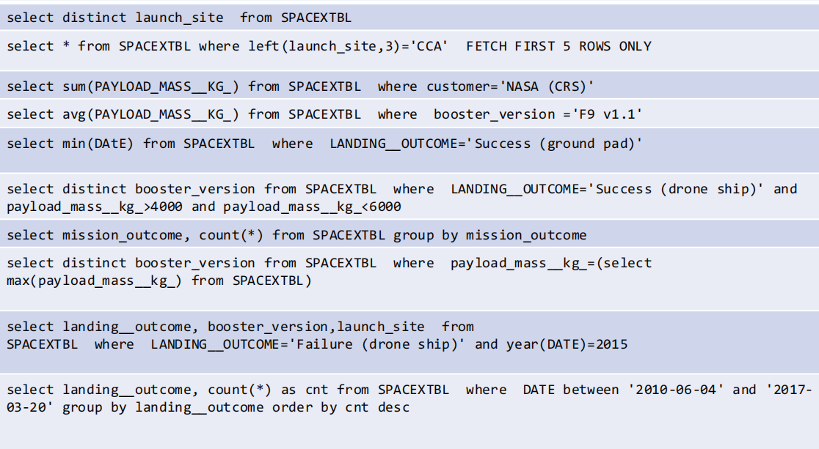
EDA with SQL
Using bullet point format, summarize the SQL queries you performed
Add the GitHub URL of your completed EDA with SQL notebook, as an external reference and peer-review purpose

Slide 16
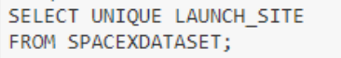
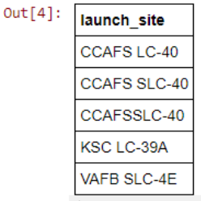
All Launch Site Names
Actually only 3 unique launch_site values: CCAFS
SLC-40, KSC LC-39A,VAFB SLC-4E
As data entry error, CCAFS LC-40, CCAFS SLC-40 and CCAFSSLC-40 are recognized as different site name.

Slide 17
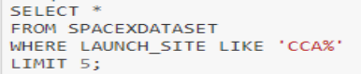
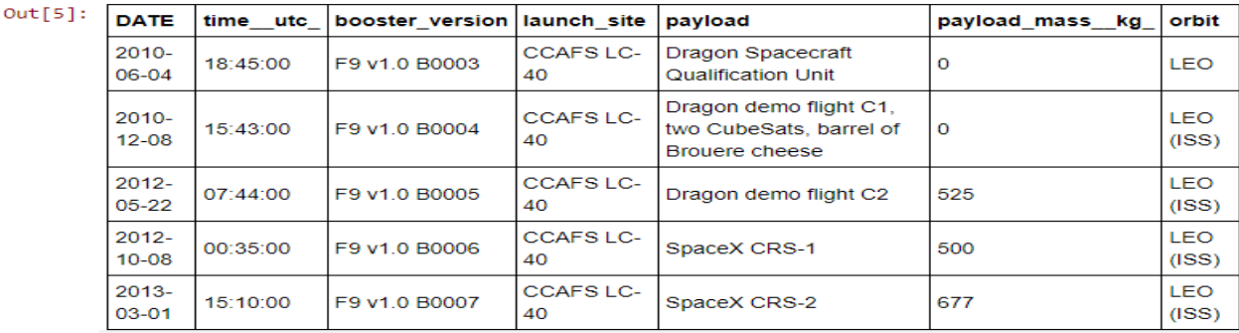
Launch Site Names Begin with 'CCA'
List the first 5 records of the site begin with ‘CCA’

Slide 18
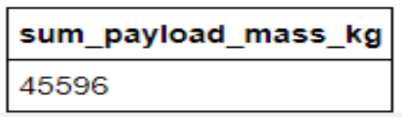
Total Payload Mass from ‘NASA’
It sums the total payload mass in kg where the customer was NASA.

Slide 19
Average Payload Mass by F9 v1.1
Calculate the average payload mass carried by booster version F9 v1.1
Present your query result with a short explanation here

Slide 20
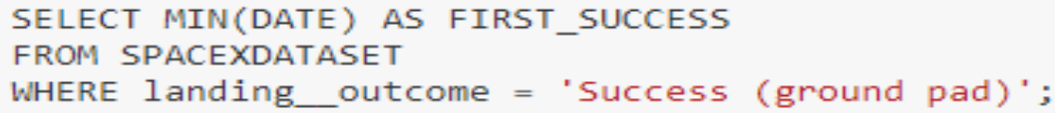
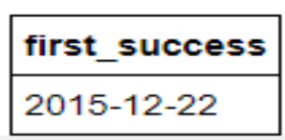
First Successful Ground Landing Date
Find the dates of the first successful landing outcome on ground pad

Slide 21
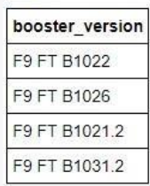
Successful Drone Ship Landing with Payload between 4000 and 6000
List the names of boosters which have successfully landed on drone ship and had payload mass greater than 4000 but less than 6000

Slide 22
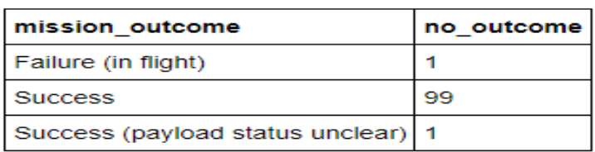
Total Number of Successful and Failure Mission Outcomes
Calculate the total number of successful and failure mission outcomes

Slide 23
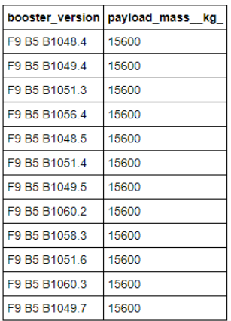
Boosters Carried Maximum Payload
List the names of the booster which have carried the maximum payload mass

Slide 24
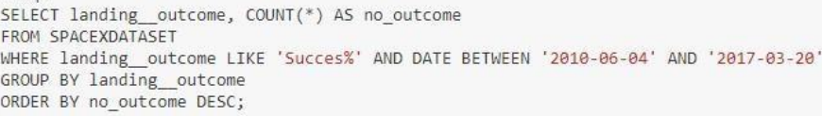
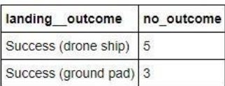
Rank Landing Outcomes Between 2010-06-04 and 2017-03-20
Rank the count of landing outcomes (such as Failure (drone ship) or Success (ground pad)) between the date 2010-06-04 and 2017-03-20, in descending order

Slide 25
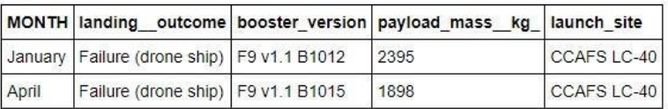
2015 Failed Drone Ship Landing Records
List the failed landing_outcomes in drone ship, their booster versions, and launch site names for in year 2015

Slide 26
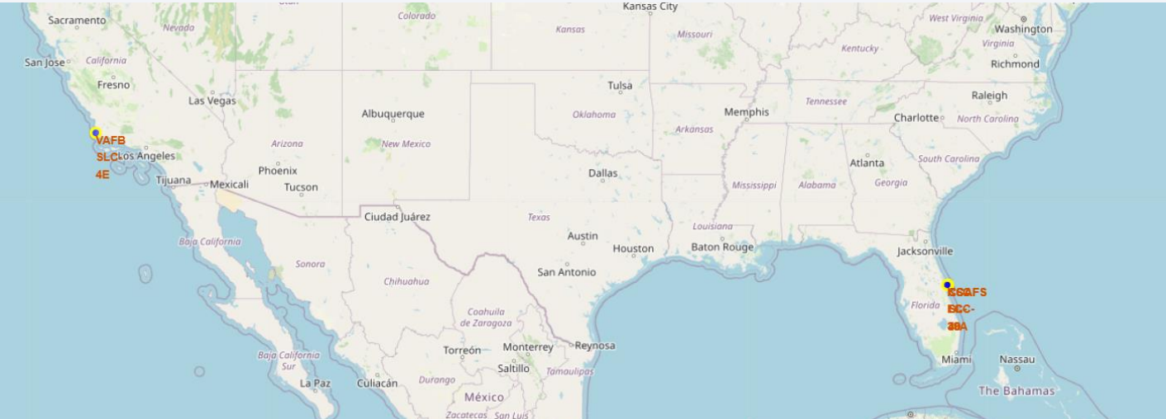
Build an Interactive Map with Folium
Folium maps mark Launch Sites, successful and unsuccessful landings, and a proximity
example to key locations: Railway, Highway, Coast, and City.

Slide 27
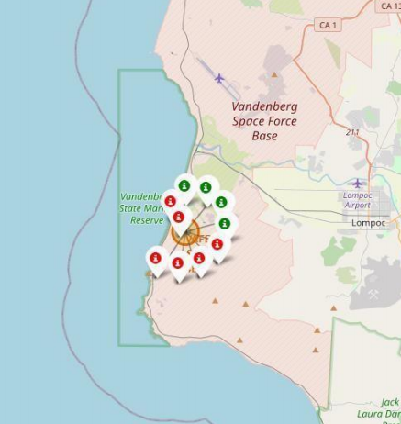
Colored Folium Map
Green icon is the successful landing .
Red icon is the failed landing.
In this example, it shows 4 successful landings and 6
failed landings.

Slide 28
Build a Dashboard with Plotly Dash
Build an interactive dashboard using Plotly Dash to display launch site maps and success rate heat maps, and provide dynamic demonstration screenshots of real-time prediction of input parameters.

Slide 29
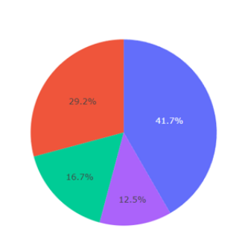
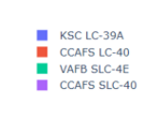
Successful launches by sites
Build an interactive dashboard using Plotly Dash to display launch site maps and success rate heat maps, and provide dynamic demonstration screenshots of real-time prediction of input parameters.

Slide 30
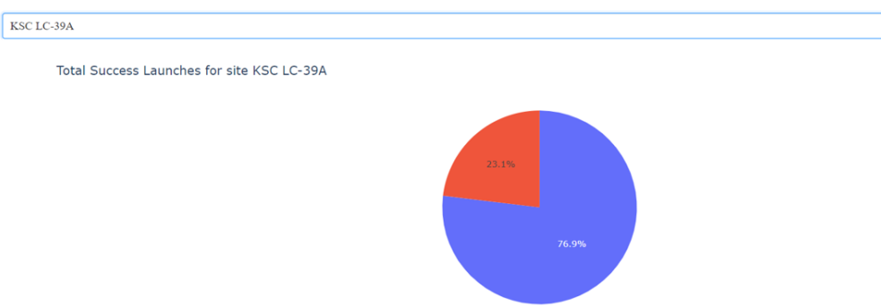
Highest success Rate Launch site
Site KSC LC-39A has success rate equals 76.9%, so it is the most successful launch site.

Slide 31
Predictive Analysis (Classification)
Model selection
Comparative logistic regression SVM、 The F1 score of models such as random forest is used to select the best performing random forest (F1=0.86).
Importance of Features
By using the feature ranking map of the random forest, identify the features that have the greatest impact on the prediction results, such as' flight number 'and' orbit type '.

Slide 32
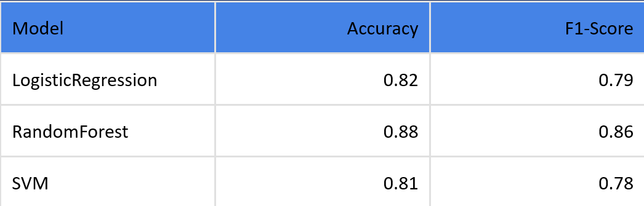
Predictive Analysis (Classification)
Cross validation
Using K-fold cross validation methods (such as sklearn. KFold) to avoid overfitting of the model and ensure its generalization ability.

Slide 33
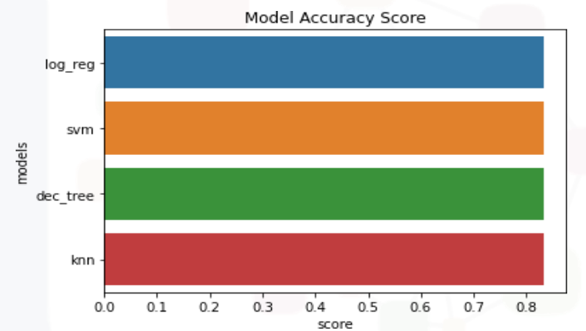
Classification Accuracy
With small sample size of 18, all four models have approximately the same accuracy 83.33%

Slide 34
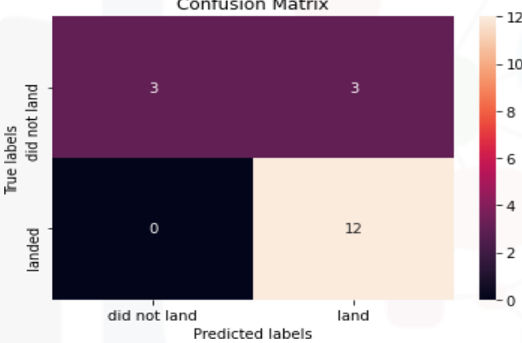
Confusion Matrix
The confusion matrix is the same across all models.

Slide 35
Results
Exploratory data analysis results:
Payload_mass>10000kg and Falcon 9 launched on LC-39A, with a success rate of over 92% for the first stage landing of the rocket
Four ML models were build:logistic regression,SVM,Decision Tree,KNN. Models appeared to be equally successful in terms of determining launch success.

Slide 36
Conclusions
Value of the project:
The model can effectively help startups evaluate risks in rocket launch bidding, and is expected to reduce related bidding costs by 30%.
Limitation:
The data of the current model is time sensitive (up to 2023), and improvements such as adding real-time meteorological features can be made in the future.
…

Slide 37


